Slide 1
The WHO proposals for pandemic preparedness and response
David Bell
April 19, 2023

Slide 2
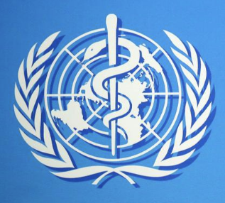
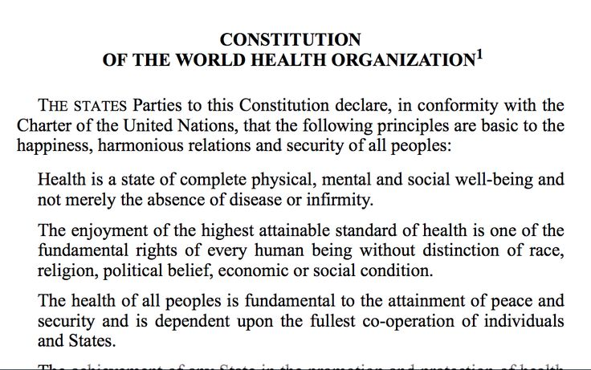
World Health Organization origins
World Health Organization Constitution – signed 22 July 1946
By 51 UN nations, +10 others
Era of Nuremburg, decolonization, disillusionment with authoritarianism
Governed by World Health Assembly (WHA): Country-controlled; One nation – One vote.
Budget: Core funding (‘Assessed’ country allocations) – WHO determines priorities under guidance of WHA

Slide 3
WHO: Intervening years
Alma Ata Declaration, 1978:
Article IV: … The people have the right and duty to participate individually and collectively in the planning and implementation of their health care.
Primary care, in Article VII(5): … requires and promotes maximum community and individual self-reliance and participation in the planning, organization, operation and control of primary health care, …
Local decision-making, decentralized, horizontal, community empowerment etc……
What happened?

Slide 4
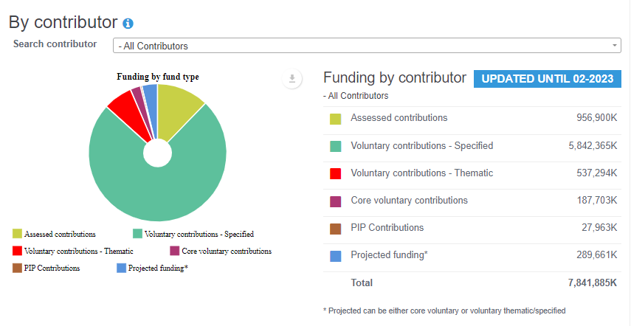
WHO budget 2022-23
https://open.who.int/2022-23/contributors/contributor

Slide 5
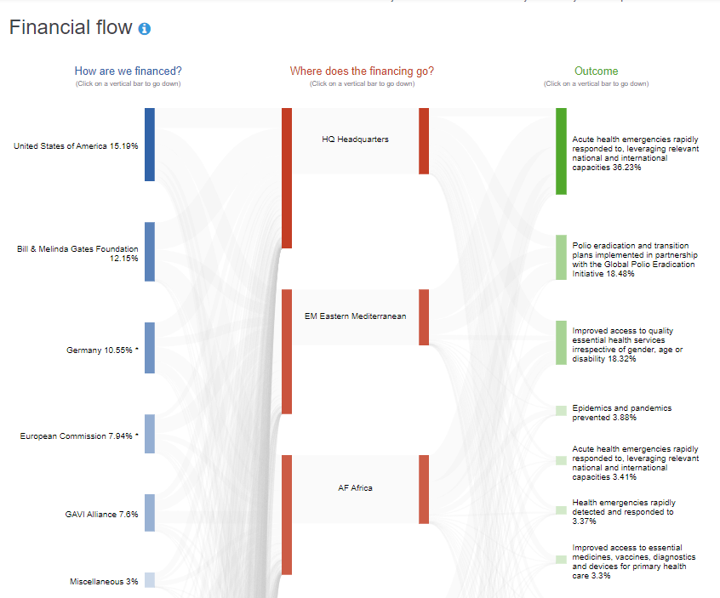
WHO budget 2022-23
https://open.who.int/2022-23/contributors/contributor
USA
Gates Foundation
Germany
Euro Commission
Gavi

Slide 6
COVID-19
A new pandemic for the new WHO

Slide 7
WHO pandemic flu NPI Guidelines, 2019
Isolation of sick individuals:

Slide 8
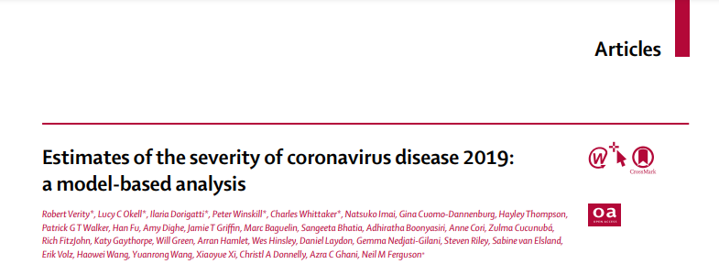
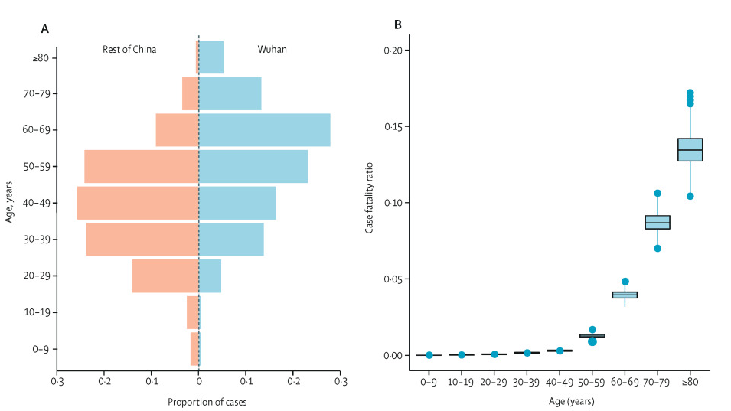
COVID-19 mortality: Rare in young and mid-aged people – known early 2020
Verity et al. (Imperial College) Lancet March 2020.
https://www.thelancet.com/journals/laninf/article/PIIS1473-3099(20)30243-7/fulltext

Slide 9
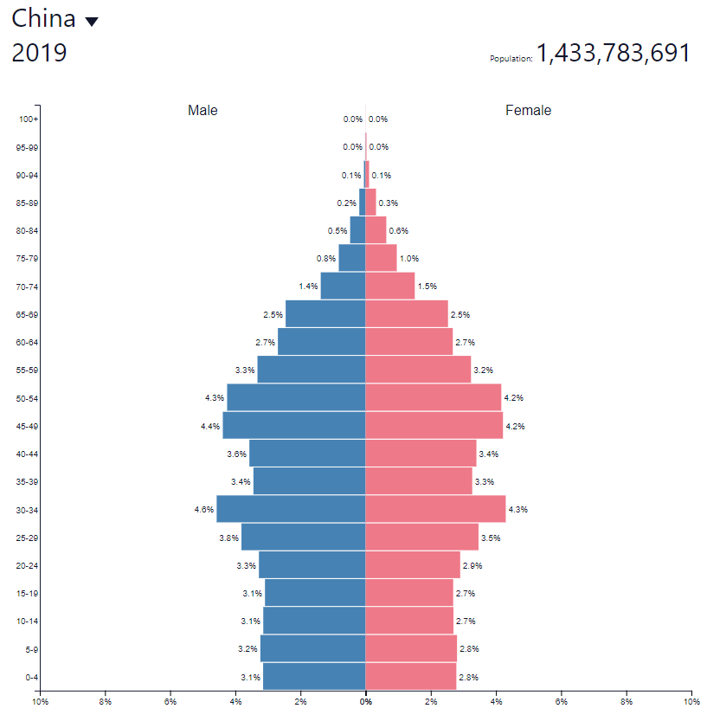
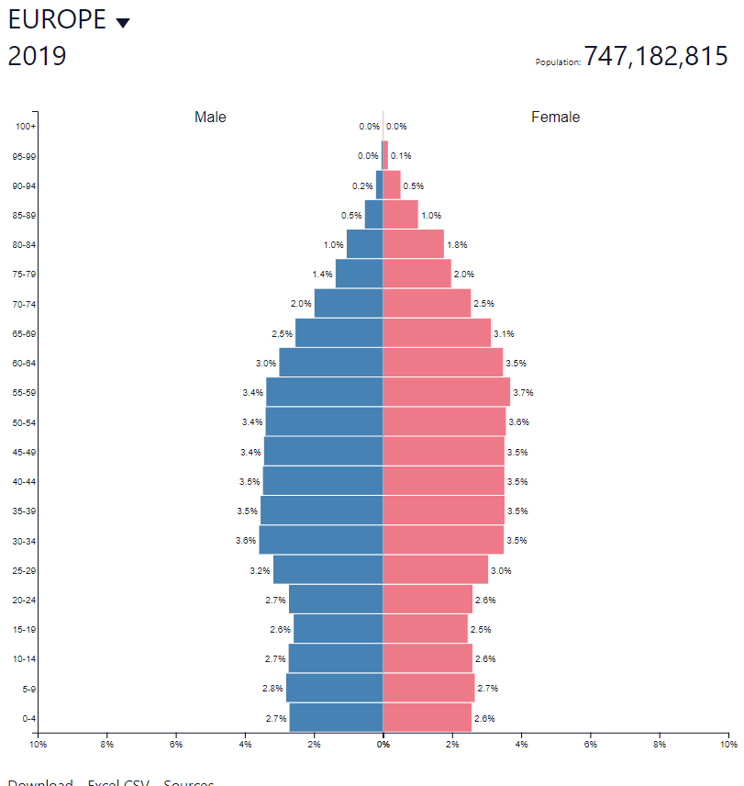
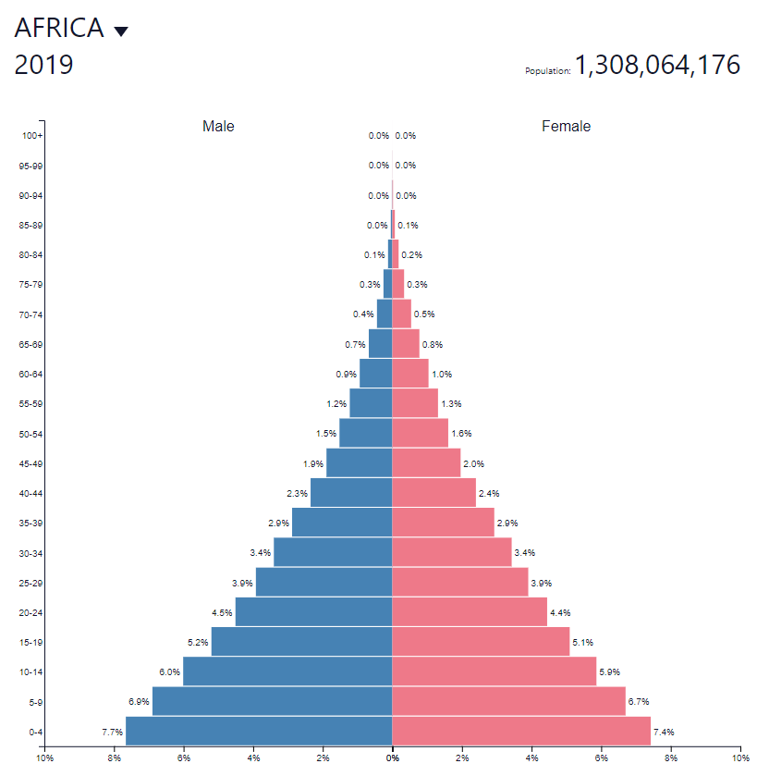
Population age structures – WHO ignored risk profiles
https://www.populationpyramid.net/
Obesity and diabetes also rarer in sub-Saharan Africa

Slide 10
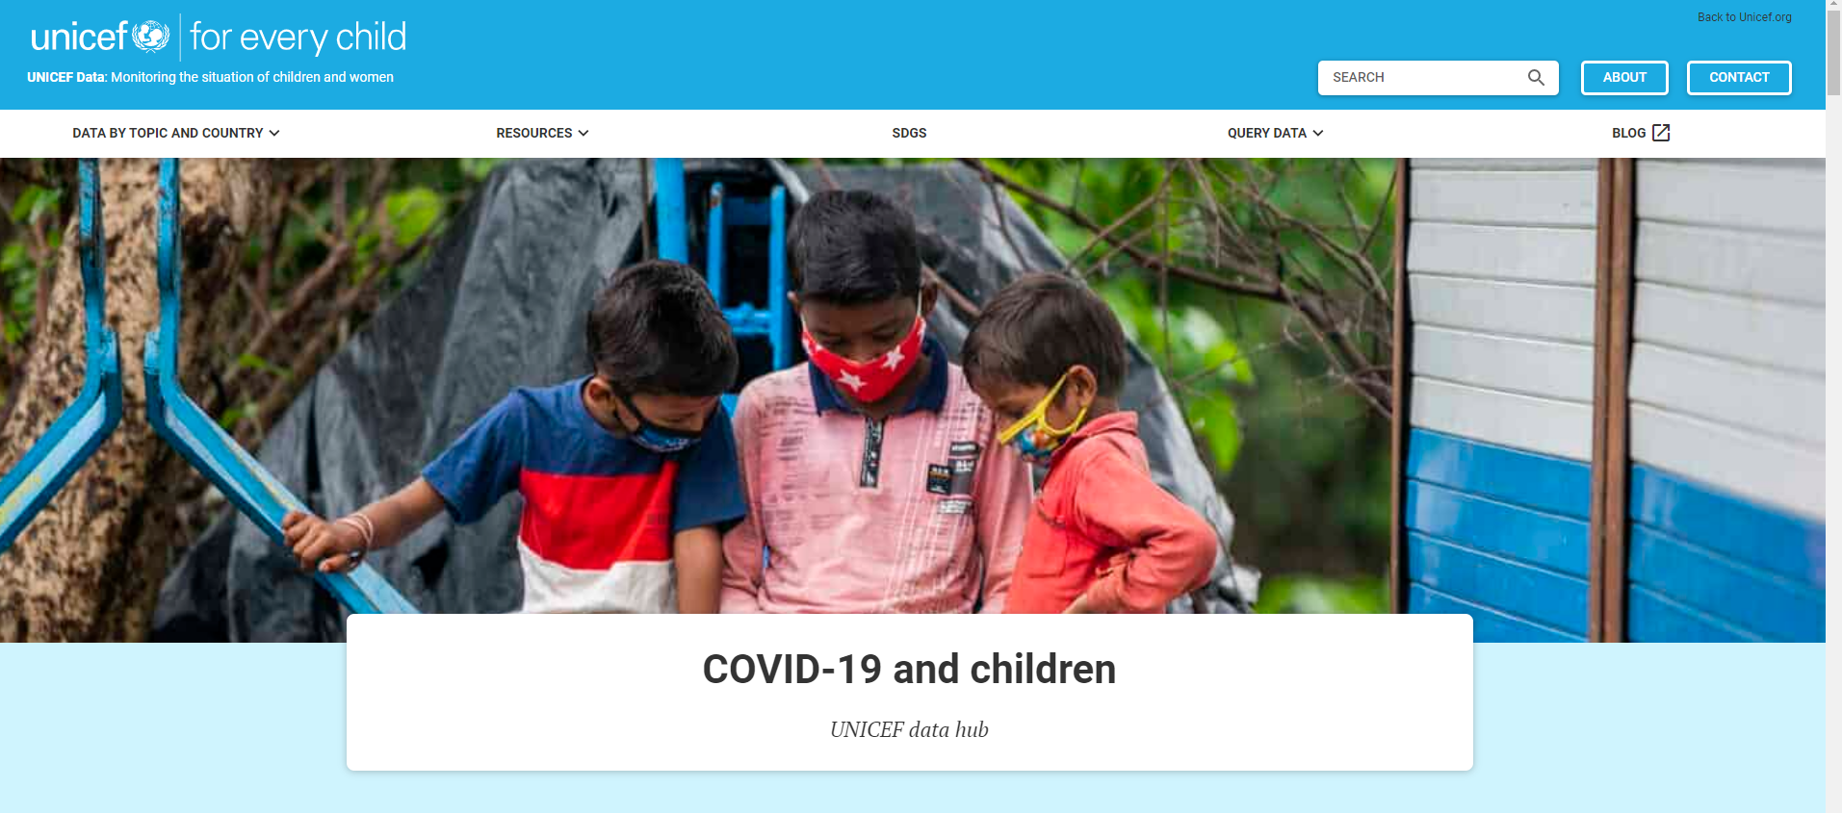
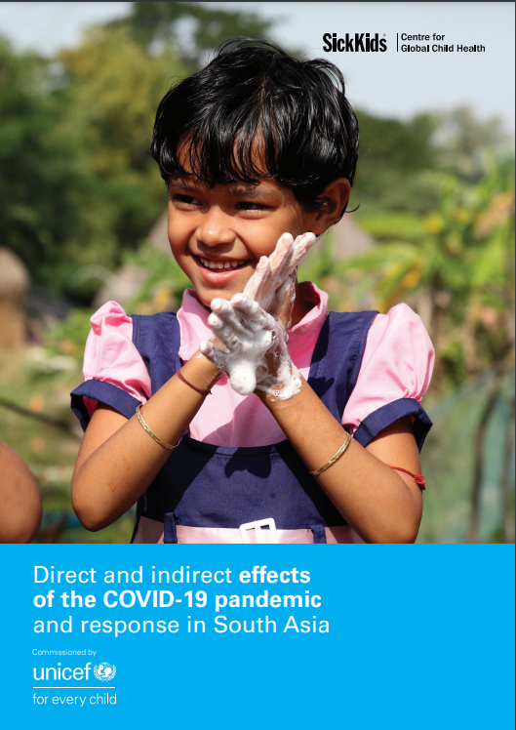
Mass poverty, hunger and ill-health destabilize the world
UNICEF late 2021
UNICEF March 2021
https://data.unicef.org/covid-19-and-children/
Global
+100M children in poverty
+200,000 stillbirths
+80M <1yo miss childhood vaccination
+10M child marriages within decade
…..
https://www.unicef.org/rosa/media/13066/file/Main%20Report.pdf
South Asia:
420M children out of school (~9M permanent)
~228,641 est. additional dead children <5yo (vs. 2019)
~405,640 added teenage pregnancies
https://blogs.worldbank.org/opendata/understanding-global-debt-relieving-covid-19-impact-most-vulnerable

Slide 11
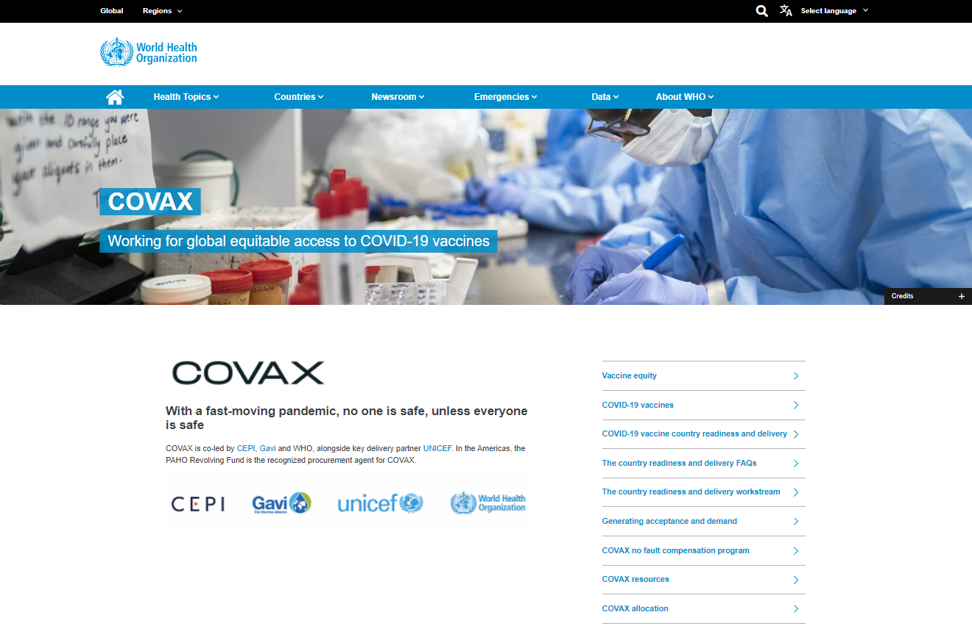
COVAX: WHO’s mass Covid vaccination programme
“With a fast-moving pandemic, no one is safe, unless everyone is safe”
This means vaccine does not protect the vaccinated. So what is going on?

Slide 12
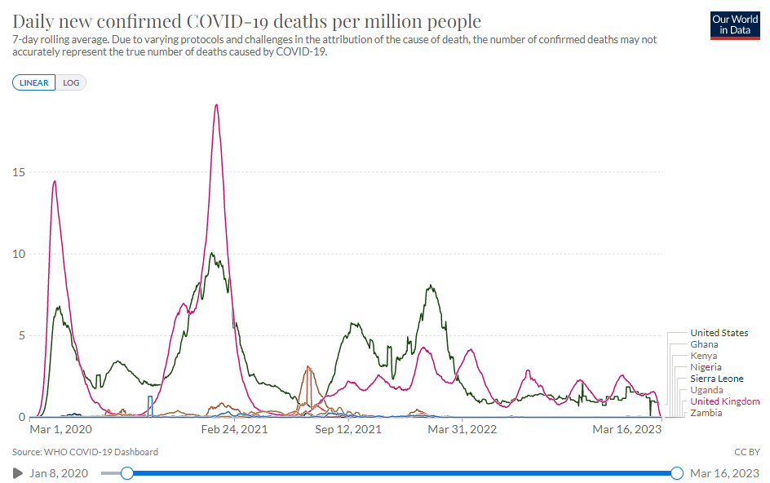
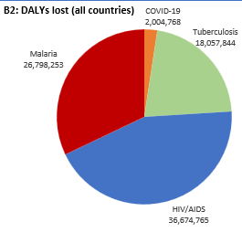
Africa – low Covid mortality, rising burdens of other diseases
USA
Ghana, Nigeria, Sierra Leone, Kenya, Uganda, Zambia
UK

Slide 13
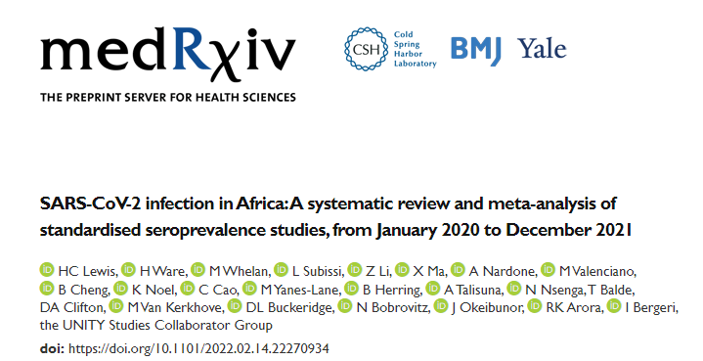
People in Africa have immunity to COVID-19 (WHO)
50% are <20 years old
https://www.medrxiv.org/content/10.1101/2022.02.14.22270934v1.full
Results We identified 54 full texts or early results, reporting 151 distinct seroprevalence studies in Africa Of these, 95 (63%) were low/moderate risk of bias studies. SARS-CoV-2 seroprevalence rose from 3.0% [95% CI: 1.0-9.2%] in Q2 2020 to 65.1% [95% CI: 56.3-73.0%] in Q3 2021. The ratios of seroprevalence from infection to cumulative incidence of confirmed cases was large (overall: 97:1, ranging from 10:1 to 958:1) and steady over time. Seroprevalence was highly heterogeneous both within countries - urban vs. rural (lower seroprevalence for rural geographic areas), children vs. adults (children aged 0-9 years had the lowest seroprevalence) - and between countries and African sub-regions (Middle, Western and Eastern Africa associated with higher seroprevalence).

Slide 14
Costs of mass vaccination – 2 doses for Africa only
Africa CDC estimate: ~$10B for 2 doses
COVAX facility so far: >$7.5B (mainly government [Western tax-payer] funding).
For comparison:
WHO (2022) annual budget (all activities): ~$3.5B
Total annual global malaria spend: ~$3B
Total Global Fund annual budget (Malaria, TB, HIV): ~$4.0B

Slide 15
Who gains from COVAX?

Slide 16
Pandemic Preparedness and Response (PPR): Making all this permanent

Slide 17
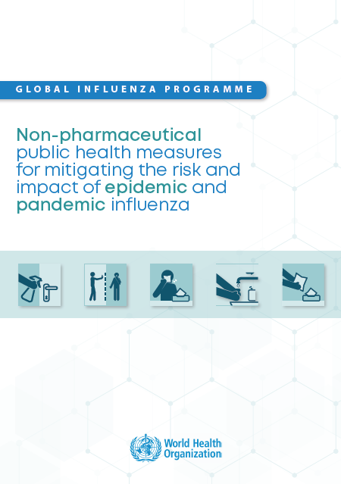
Pandemics are now rare, with low overall disease burden
Pandemics are rare events
Mortality is low since antibiotics became available
Should drop further with modern medical care.
WHO, November 2019

Slide 18
The new pandemic industry.
“Pandemics are becoming more frequent” (False)
“There is increasing interaction between humans and wildlife or livestock”. (Illogical)
Surveil for variants…
Mass vax out of pandemic
Salaries, job security, travel, prestige
Declare risk
Mainly public money
Corporate /investor profit
Lockdown, restrict

Slide 19
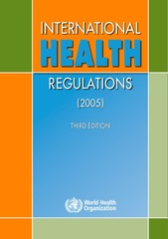
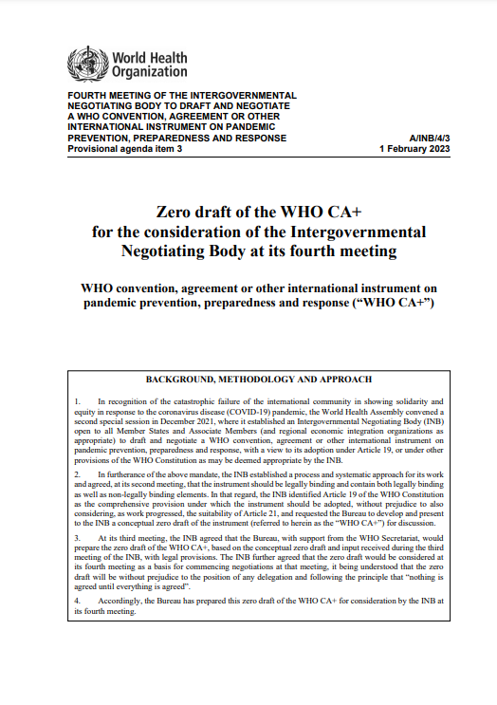
WHO pandemic preparedness and response instruments.
International Health Regulations (IHR) amendments
Provides the teeth to the WHO’s goal of increased control over health emergencies
IHR has force under international law
Currently 196 signatories
Negotiated by the WGIHR (Working Group)
WHO ‘CA+’ (treaty)
Provides financing, governance and supply network for the above.
Negotiated by the INB (Int. Neg. Body)

Slide 20
IHR draft amendments
Expand the definitions of pandemics & health emergencies, including the introduction of ‘potential’ for harm rather than actual harm. It also expands the definition of health products that fall under this to include any commodity or process that may impact on the response or “improve quality of life”.
Change the recommendations of the IHR from ‘non-binding’ to mandatory instructions that the States undertake to follow and implement.
Solidify the Director General’s ability to independently declare emergencies.
Set up an extensive surveillance process in all States, which WHO will verify regularly through a country review mechanism.
Enable WHO to share country data without consent.
Give WHO control over certain country resources, including requirements for financial contributions, and provision of intellectual property and know-how (within the broad definition of health products above).
Ensure national support for promotion of censorship to prevent contrary approaches and concerns from being freely disseminated.
Change existing IHR provisions affecting individuals from non-binding to binding will include:
Travel restrictions, refusal of entry
Confinement (isolation),
Mandated medical examinations
Mandated vaccination
….

Slide 21
CA+ (Treaty)
Set up an international supply network overseen by WHO
Fund the structures and processes by requiring ≥5% of national health budgets to be devoted to health emergencies.
Set up a ‘Governing Body’, under WHO auspices, to oversee the whole process.
Expand scope by emphasizing a ‘One Health’ agenda, being defined as a recognition that a very broad range of aspects of life and the biosphere can impact health, and therefore fall under the ‘potential’ to spread harm across borders as an international health emergency.

Slide 22
Timeline: IHR amendments
WHA May 2024: majority vote (of 196 States)
March 2025: End of 10 month rejection period
May 2025: Comes into force.
If opt out, then previous IHR (2005) version applies to that state, not the amendments.

Slide 23
Timeline: INB ‘CA+’ (treaty)
WHA May 2024: 2/3 vote of 194 member states
Requires 30 countries to ratify
Then comes into force (for those countries) 30 days later.
(Based on current draft)

Slide 24
Summary
Pandemics are relatively rare, low-burden events
WHO’s recent record (Covid) is incompetent, and against public health principles
Rational approaches would recognize national and local priorities
Health policy must be free of conflict of interest.
Current directions for pandemic preparedness will ensure repeated ‘emergencies’ with additive harm
Legislators urgently need to protect democracy from predatory corporate greed, expressed through corruption of public health

Slide 25
Thank you

Slide 26
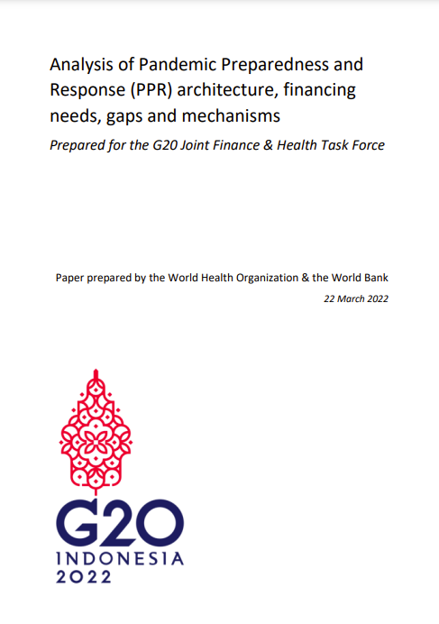
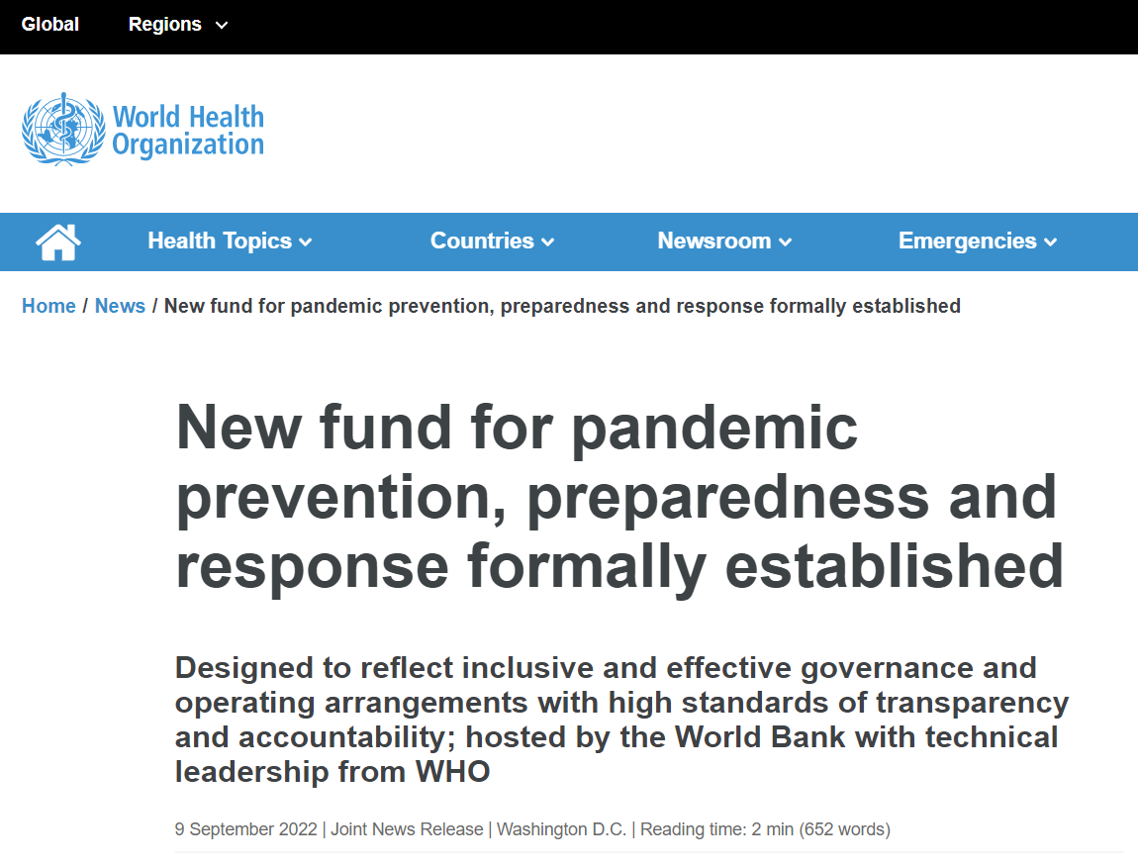
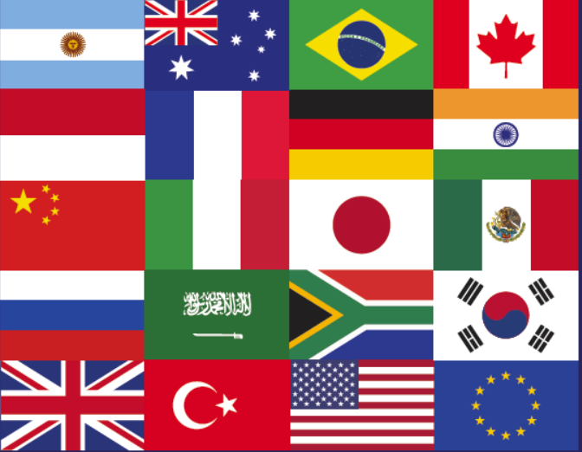
World Bank Pandemic FIF (Financial Intermediary Fund)

